Slide 1
Pattern discovery and cancer gene identification in integrated cancer genomic data
Dongfang Wang
2013-09-30

Slide 2

Introduction
background
Large-scale cancer genome characterization
Discover cancer subtypes and their molecular drivers in a comprehensive
genetic context
existing methods
not designed to include both discrete and continuous variables
cannot systematically distinguishing cancer genes that are reliable and constant
features of a subtype from those that are less reliable

Slide 3
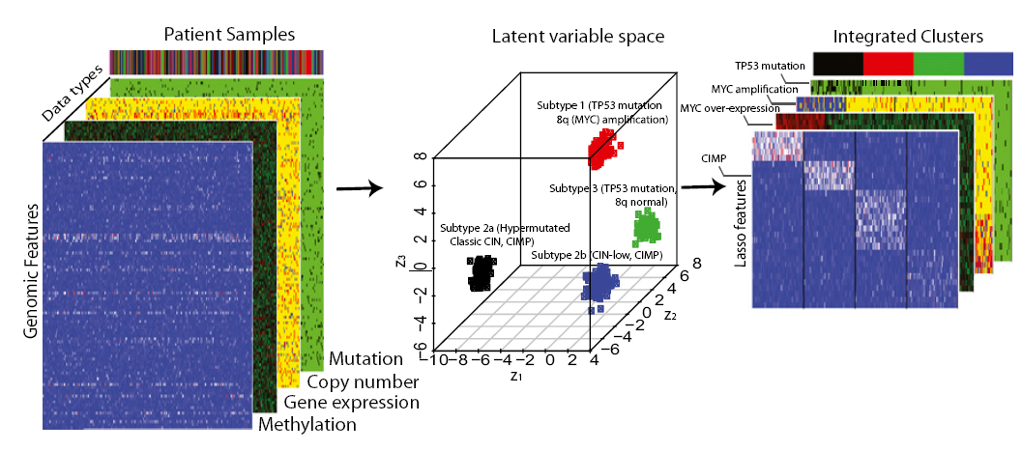
overview
hypothesis: diverse molecular phenotypes can be predicted by a set of orthogonal
latent variables that represent distinct molecular drivers
reveal tumor subgroups of biological and clinical importance

Slide 4







clusters:
different cancer types;
different molecular drivers
$$x_{2},….$$
$$x_{n},….$$
$$x_{1},….$$
latent variables
$$z_{}={(z_{1}^{},z_{2}^{},…,z_{k}^{})}^{′}$$
samples
$$x_{1}$$
$$x_{2}$$
$$x_{n}$$
features

Slide 5
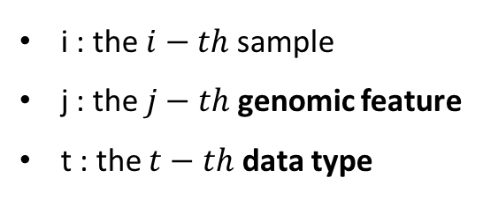



iCluster+ framework
genomic variable :
$$x_{ijt}$$
latent variable :
$$z_{i}={(z_{i1}^{},z_{i2}^{},…,z_{ik}^{})}^{′}$$
i : the $i−th$ sample
j : the $j−th$ genomic feature
t : the $t−th$ data type
$k$ distinct driving factors

Slide 6
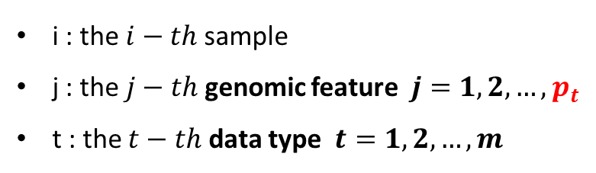

genomic variable :
$$x_{ijt}$$
i : the $i−th$ sample
j : the $j−th$ genomic feature $j=1,2,…,p_{t}$
t : the $t−th$ data type $t=1,2,…,m$
data type:
binary (somatic mutation)
categorical (copy number gain/loss/normal)
continuous (gene expression)
genomic features:
a protein-coding gene
non-gene-centric elements of interest (CpG sites, microRNA, etc.)

Slide 7


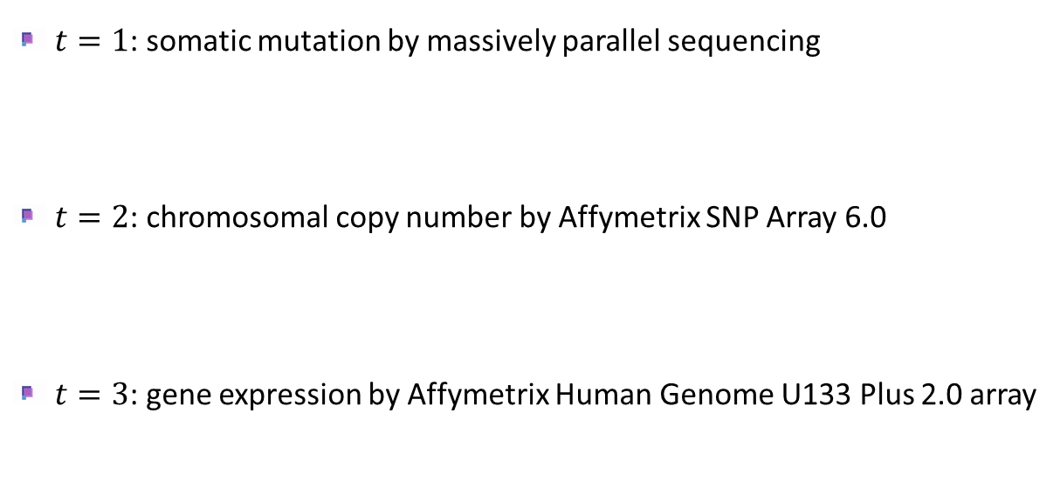

Case Study I : CCLE dataset :729 cell lines & 30 tumor types
$m=3$data types, every type has $p_{t}$genomic features
$t=1$: somatic mutation by massively parallel sequencing
$t=2$: chromosomal copy number by Affymetrix SNP Array 6.0
$t=3$: gene expression by Affymetrix Human Genome U133 Plus 2.0 array
$p_{1}=1670$genes that were mutated in $≥1\%$ of the cell lines( 1 mutated; 0 not mutated )
$p_{2}=8432$copy number regions
$p_{2}=4000$ most variable genes based on their expression profile across the cell lines

Slide 8
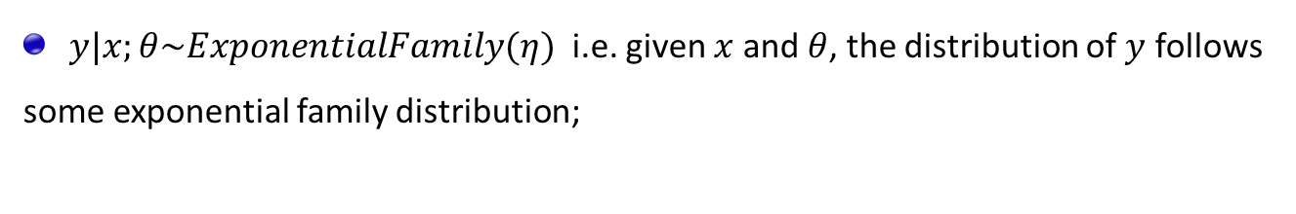
Generalized Linear Model
To drive a GLM :
$y|x;θ\sim ExponentialFamily(η)$ i.e. given $x$ and $θ$, the distribution of $y$ follows
some exponential family distribution;
Given $x$, our goal is to predict the expected value of $T(y)$given x : $h\left(x\right)=E[y|x]$
The natural parameter $η$ and the inputs $x$ are related linearly: $η=θ^{T}x$

Slide 9
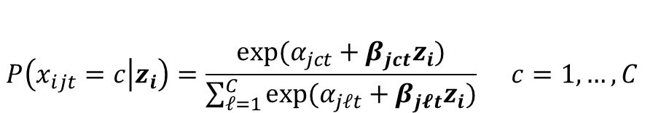
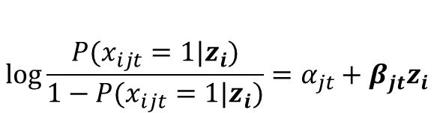
Modeling Approach
binary variable (e.g. mutation status) : logistic regression
$$\log{\frac{P(x_{ijt}=1|z_{i})}{1−P(x_{ijt}=1|z_{i})}}=α_{jt}+β_{jt}z_{i}$$
multicategory variable (e.g. copy number states: loss/normal/gain) : multilogit regression
$$P\left(x_{ijt}=c | z_{i}\right)=\frac{exp⁡(α_{jct}+β_{jct}z_{i})}{\sum_{ℓ=1}^{C}{exp⁡(α_{jℓt}+β_{j𝓵t}z_{i})}} c=1,…,C$$

Slide 10
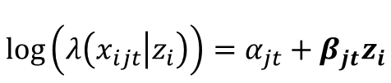

Modeling Approach (con’t)
continuous variable: (normal distribution)
$$x_{ijt}=α_{jt}+β_{jt}z_{i}+ε_{ijt} , ε_{jt}\sim N(0,σ_{jt}^{2})$$
count variable: Possion regression
$$\log\left(λ\left(x_{ijt} | z_{i}\right)\right)=α_{jt}+β_{jt}z_{i}$$
$λ$: the conditional mean of the count given $z_{i}$

Slide 11
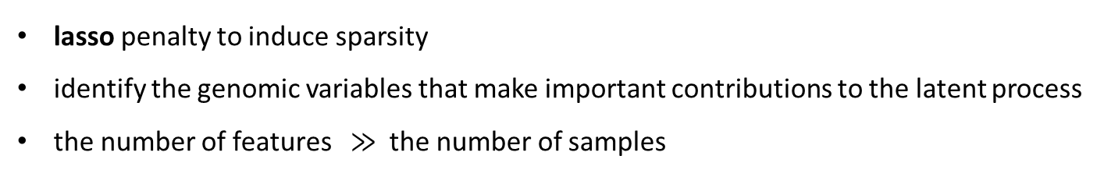
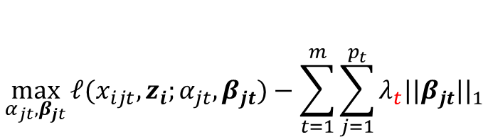
Lasso panalized likelihood approach
lasso penalty to induce sparsity
identify the genomic variables that make important contributions to the latent process
the number of features $≫$ the number of samples
$$\max_{α_{jt},β_{jt}}{ℓ(x_{ijt},z_{i};α_{jt},β_{jt})}−\sum_{t=1}^{m}{\sum_{j=1}^{p_{t}}{λ_{t}{||β_{jt}||}_{1}}}$$
Notes:
LASSO 不惩罚常数项
\lambda 的确定

Slide 12

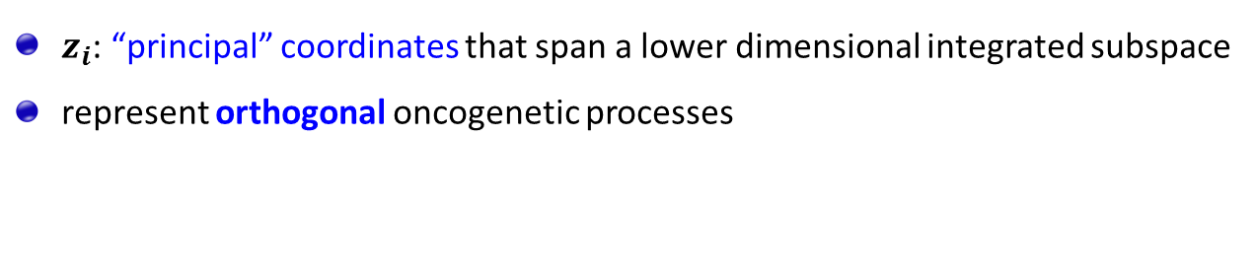
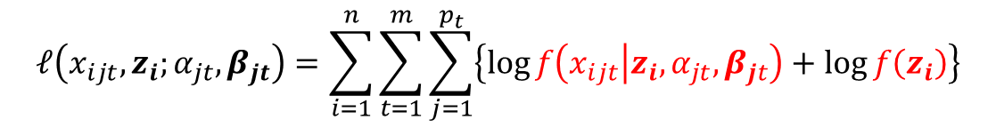
Monte Carlo Newton-Raphson Algorithm
$$\max_{α_{jt},β_{jt}}{ℓ(x_{ijt},z_{i};α_{jt},β_{jt})}−\sum_{t=1}^{m}{\sum_{j=1}^{p_{t}}{λ_{t}{||β_{jt}||}_{1}}}$$
$$ℓ\left(x_{ijt},z_{i};α_{jt},β_{jt}\right)=\sum_{i=1}^{n}{\sum_{t=1}^{m}{\sum_{j=1}^{p_{t}}{\left\{\log{f\left(x_{ijt} | z_{i},α_{jt},β_{jt}\right)}+\log{f\left(z_{i}\right)}\right\}}}}$$
(conditional independence)
$f\left(z_{i}\right)$ : standard multivariate normal distribution $N(0,I_{k})$
$z_{i}$: “principal” coordinates that span a lower dimensional integrated subspace
represent orthogonal oncogenetic processes
There is increasing evidence that molecular drivers tend to be altered in mutually
exclusive sets of patients, representing distinct oncogenic mechanisims

Slide 13
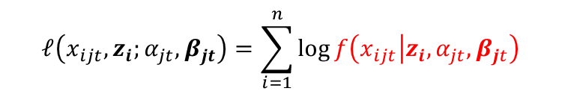


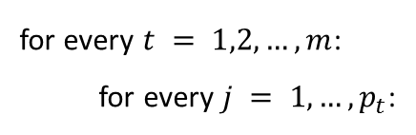

$$\max_{α_{jt},β_{jt}}{ℓ(x_{ijt},z_{i};α_{jt},β_{jt})}−\sum_{t=1}^{m}{\sum_{j=1}^{p_{t}}{λ_{t}{||β_{jt}||}_{1}}}$$
$$\sum_{t=1}^{m}{p_{t}}$$
divide into separable optimization problem: (conditional on $z_{i}$)
for every $t = 1,2,…,m$:
for every $j = 1,…,p_{t}$:
$$ℓ\left(x_{ijt},z_{i};α_{jt},β_{jt}\right)=\sum_{i=1}^{n}{\log{f\left(x_{ijt} | z_{i},α_{jt},β_{jt}\right)}}$$
$$\max_{α_{jt},β_{jt}}{ℓ}−λ_{t}{||β_{jt}||}_{1}$$
solve the problem using a quadratic approximation and coordinate descent algorithm
Friedman J, Hastie T, Tibshirani R (2010) Regularized paths for generalized linear models via coordinate descent. J Stat Softw 33(1):1–22.

Slide 14
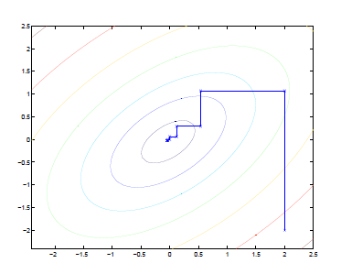
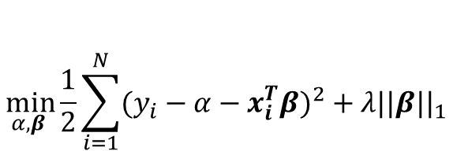
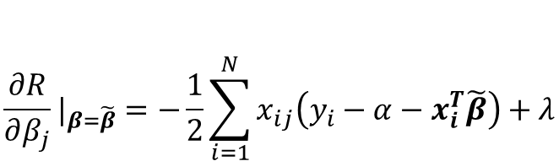

LASSO linear regression:
$$\min_{α,β }{\frac{1}{2}\sum_{i=1}^{N}{{(y_{i}−α−x_{i}^{T}β)}^{2}}}+λ{||β||}_{1}$$
Suppose we have estimates $\tilde{α}$and $\tilde{β_{l}} l≠j$ , and partially optimize with respect to $β_{j}$
if $\tilde{β_{j}}>0$
$$\frac{∂R}{∂β_{j}}|_{β=\tilde{β}}=−\frac{1}{2}\sum_{i=1}^{N}{x_{ij}\left(y_{i}−α−x_{i}^{T}\tilde{β}\right)}+λ$$
coordinate descent

Slide 15
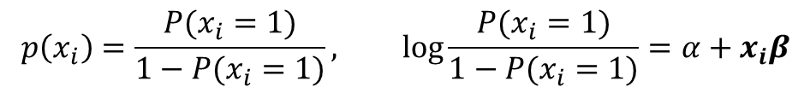
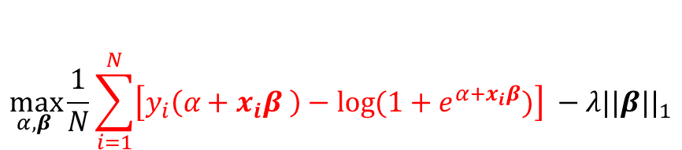

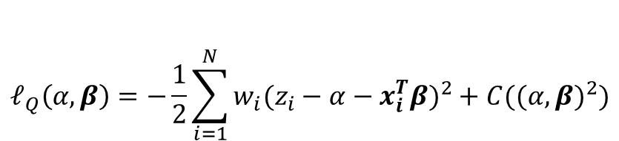
LASSO logistic regression:
$$\max_{α,β }{\frac{1}{N}\sum_{i=1}^{N}{\left[y_{i}\left(α+x_{i}β \right)−\log{(1+e^{α+x_{i}β}})\right] }}−λ{||β||}_{1}$$
$$p\left(x_{i}\right)=\frac{P(x_{i}=1)}{1−P(x_{i}=1)}, \log{\frac{P(x_{i}=1)}{1−P(x_{i}=1)}}=α+x_{i}β$$
concave function of the parameters ---- Newton algorithms
quadratic approximation (Taylor expansion):
$$ℓ_{Q}\left(α,β\right)=−\frac{1}{2}\sum_{i=1}^{N}{w_{i}({z_{i}−α−x_{i}^{T}β)}^{2}}+C({(α,β)}^{2})$$
$z_{i}=α+x_{i}^{T}β+\frac{y_{i}−\tilde{p}(x_{i})}{\tilde{p}(x_{i})(1−\tilde{p}(x_{i}))}$ $w_{i}$= $\tilde{p}(x_{i})(1−\tilde{p}(x_{i}))$

Slide 16
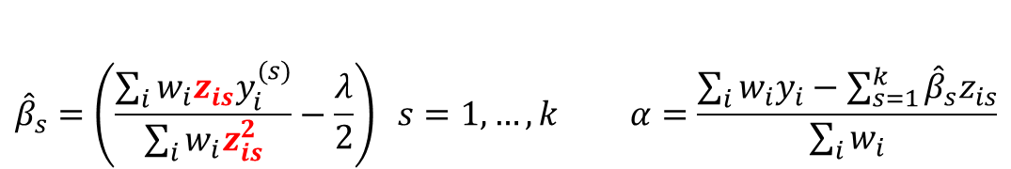
$$\max_{α_{jt},β_{jt}}{ℓ(x_{ijt},z_{i};α_{jt},β_{jt})}−\sum_{t=1}^{m}{\sum_{j=1}^{p_{t}}{λ_{t}{||β_{jt}||}_{1}}}$$
$$\sum_{t=1}^{m}{p_{t}}$$
divide into separable optimization problem: (conditional on $z_{i}$)
for every $t = 1,2,…,m$:
for every $j = 1,…,p_{t}$:
$$ℓ\left(x_{ijt},z_{i};α_{jt},β_{jt}\right)=\sum_{i=1}^{n}{\log{f\left(x_{ijt} | z_{i},α_{jt},β_{jt}\right)}}$$
$$\max_{α_{jt},β_{jt}}{ℓ}−λ_{t}{||β_{jt}||}_{1}$$
solve the problem using a quadratic approximation and coordinate descent algorithm
iterate update:
$${\hat{β}}_{s}=\left(\frac{\sum_{i}{w_{i}z_{is}y_{i}^{(s)}}}{\sum_{i}{w_{i}z_{is}^{2}}}−\frac{λ}{2}\right) s=1,…,k α=\frac{\sum_{i}{w_{i}y_{i}−\sum_{s=1}^{k}{{\hat{β}}_{s}z_{is}}}}{\sum_{i}{w_{i}}}$$

Slide 17

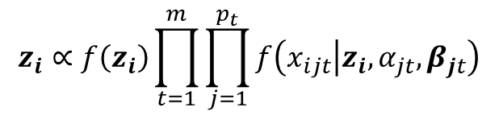
unobserved $z_{i}$
EM algorithm
Monte Carlo Markov Chain
$$z_{i}∝f\left(z_{i}\right){\prod_{t=1}^{m}{\prod_{j=1}^{p_{t}}{f\left(x_{ijt} | z_{i},α_{jt},β_{jt}\right)}}}$$

Slide 18
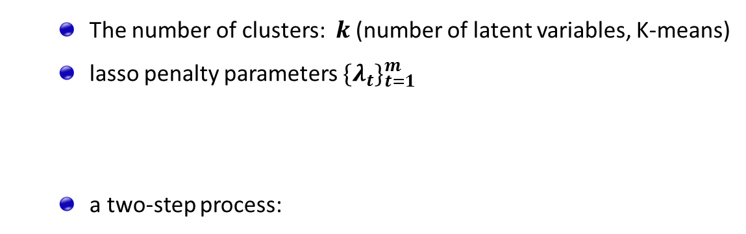
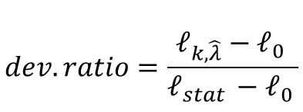
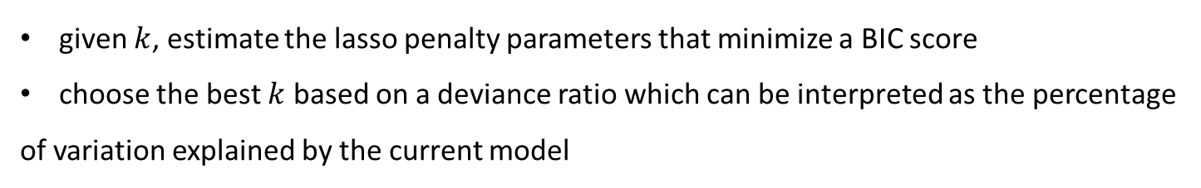
Model Selection
The number of clusters: $k$ (number of latent variables, K-means)
lasso penalty parameters ${\{λ_{t}\}}_{t=1}^{m}$
a two-step process:
given $k$, estimate the lasso penalty parameters that minimize a BIC score
choose the best $k$ based on a deviance ratio which can be interpreted as the percentage
of variation explained by the current model
$$dev.ratio=\frac{ℓ_{k,\hat{λ}}−ℓ_{0 }}{ℓ_{stat }−ℓ_{0 }}$$

Slide 19
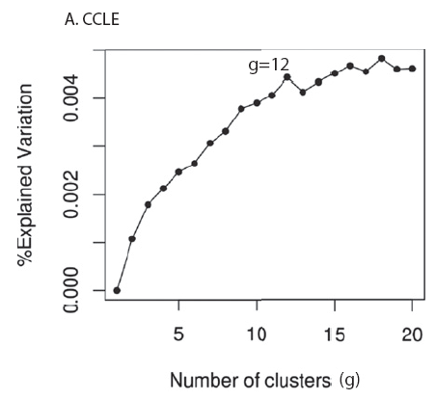
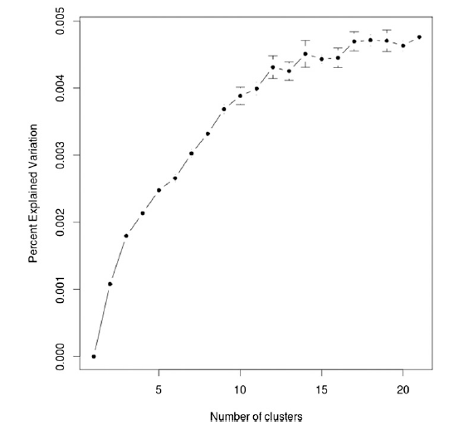
Case Study II : CCLE dataset : model selection (12 clusters)
233 mutated genes
7567 copy number rigions
3987 differentially expressed genes

Slide 20
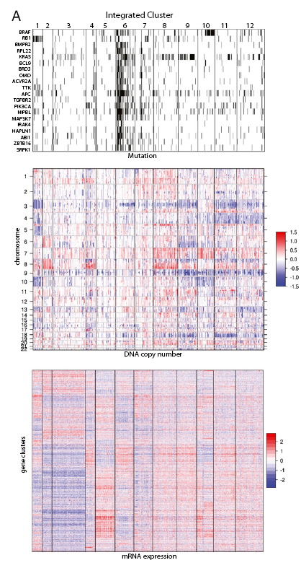
Case Study III : CCLE dataset :729 cell lines & 30 tumor types
row : features
columns: cell line samples sorted by cluster assignment
within each cluster, further sorted by tissue type
mutated(black) not mutated(white)
genomic regions amplified(red) deleted(blue)
genes overexpressed(red) underexpressed(blue)

Slide 21
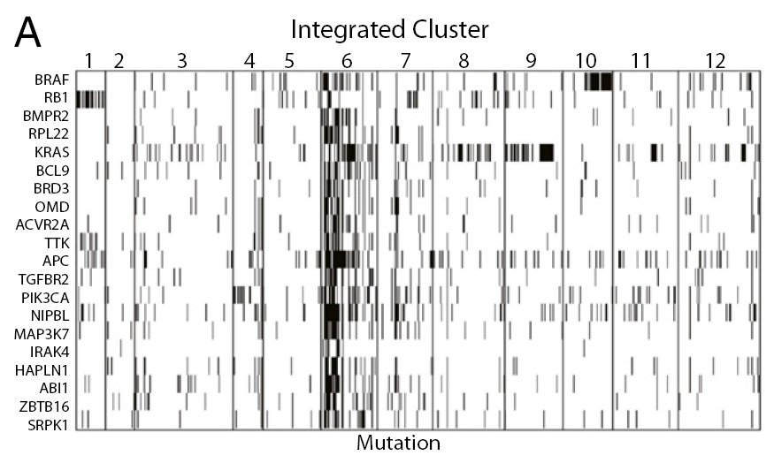
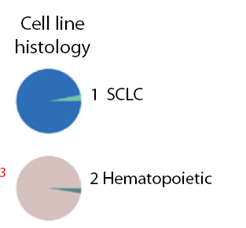
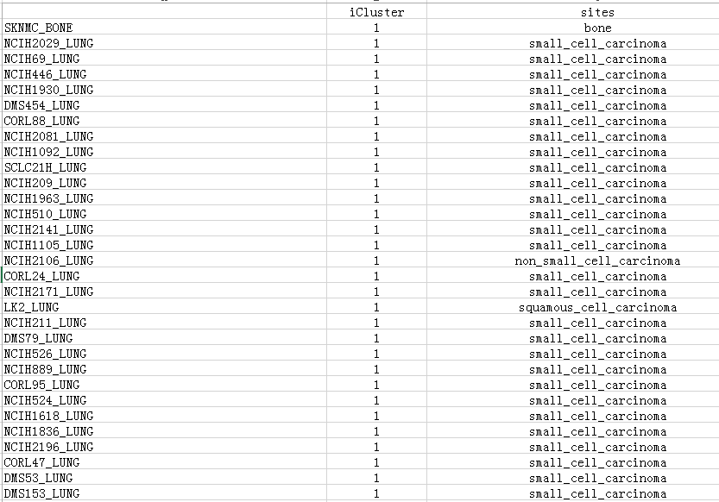
mutated (black) or not mutated (white)
known driver genes

Slide 22
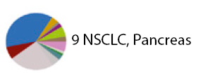

a share genetic alteration
Cluster 6 displays a hypermutated phenotype that has been well characterized in both
colon and endometrial cancers with DNA repair deficiency

Slide 23
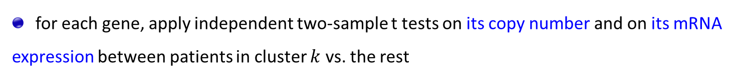
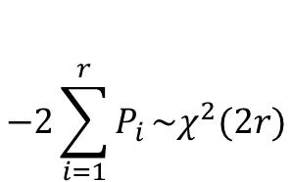
Gene-Centric Identification
highlight specific genes as ponential drivers that provide the selective advantage of
specific copy number alterations
somatic copy number alterations often span broad regions covering up to thousands of genes
for each gene, apply independent two-sample t tests on its copy number and on its mRNA
expression between patients in cluster $k$ vs. the rest
concordant events
Fisher’s method to combine the P values as
$$−2\sum_{i=1}^{r}{P_{i}}\sim χ^{2}(2r)$$

Slide 24
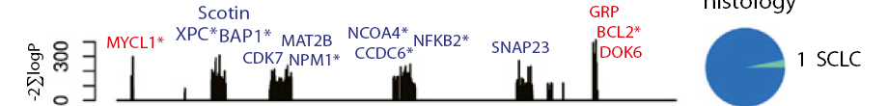
Case Study IV : CCLE dataset
red : concordant amplification/overexpression
blue: concordant loss/underexpression

Slide 25
Summary
integrate high-dimensional cancer genomic data using :
latent variables which represent distinct driver factors
generalized linear model for binomial, multinomial and continuous data types
extract novel biological information for tumor classification and cancer gene identification

Slide 26
OncomiRDB : Update
Generate the miRNA-target network
Add download page

